Slide 1
PROJECT PRESENTATION
AUTOMATIC LICENCE PLATE READING

Slide 2
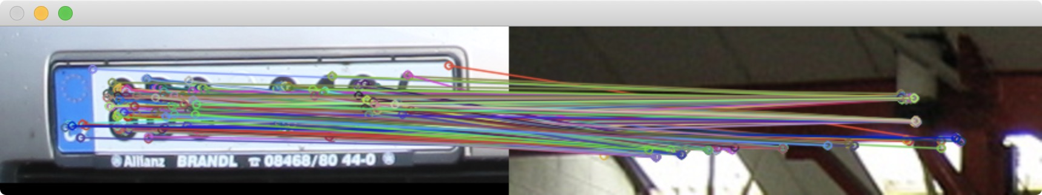
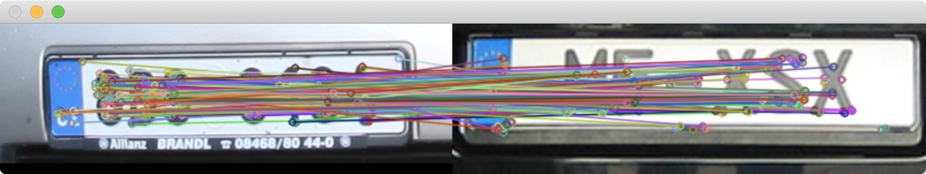
First phase: Identication of the license plate location using the sliding window approach
AUTOMATIC LICENCE PLATE READING

Slide 3
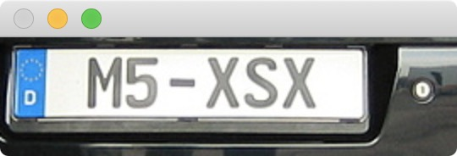
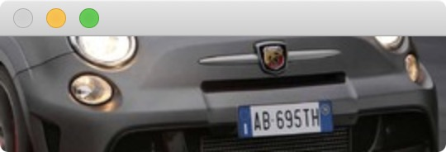
Results of the first phase
AUTOMATIC LICENCE PLATE READING

Slide 4
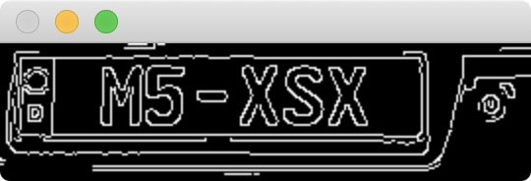
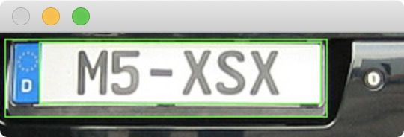

Second phase: Extract the license plate from the window that contain it
Canny algorithm
findContours() and boundingRect() with constraints
Result
min Area
AUTOMATIC LICENCE PLATE READING

Slide 5


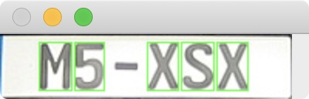
Third phase: Extract digits from licence plate image
Gray-scale conversion
Threshold
findContours() and boundingRect() with constraints
AUTOMATIC LICENCE PLATE READING
(the contours above are drawn on the original image)

Slide 6
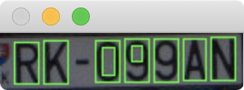
Deleting false positive characters
Discard quadrilaterals that have more than 77% of white pixels (intensity 255) on the total number of pixels.
In the threshold image (the contours above are drawn on the original image)
AUTOMATIC LICENCE PLATE READING

Slide 7
Result of the third phase
In order to obtain the correct shape for the neural network input
Resize to 20 x 20 pixel
Negative image
AUTOMATIC LICENCE PLATE READING

Slide 8
Neural Network
Architecture
Training
Classification
2D convolution layer
MaxPooling2D
2D convolution layer
MaxPooling2D
2D convolution layer
MaxPooling2D
Flatten
Dense (Fully connected layer)
Dense (softmax)
The image dataset composed of 8181 images:
7362 training set (90%)
819 validation set (10%)
After 8 epochs:
Training error: 0.0019
Estimation error: 0.01
Predict Labels: M5XSX
True Labels: M5XSX
Predict Labels: AVY351
True Labels: AB695T
AUTOMATIC LICENCE PLATE READING

Slide 9
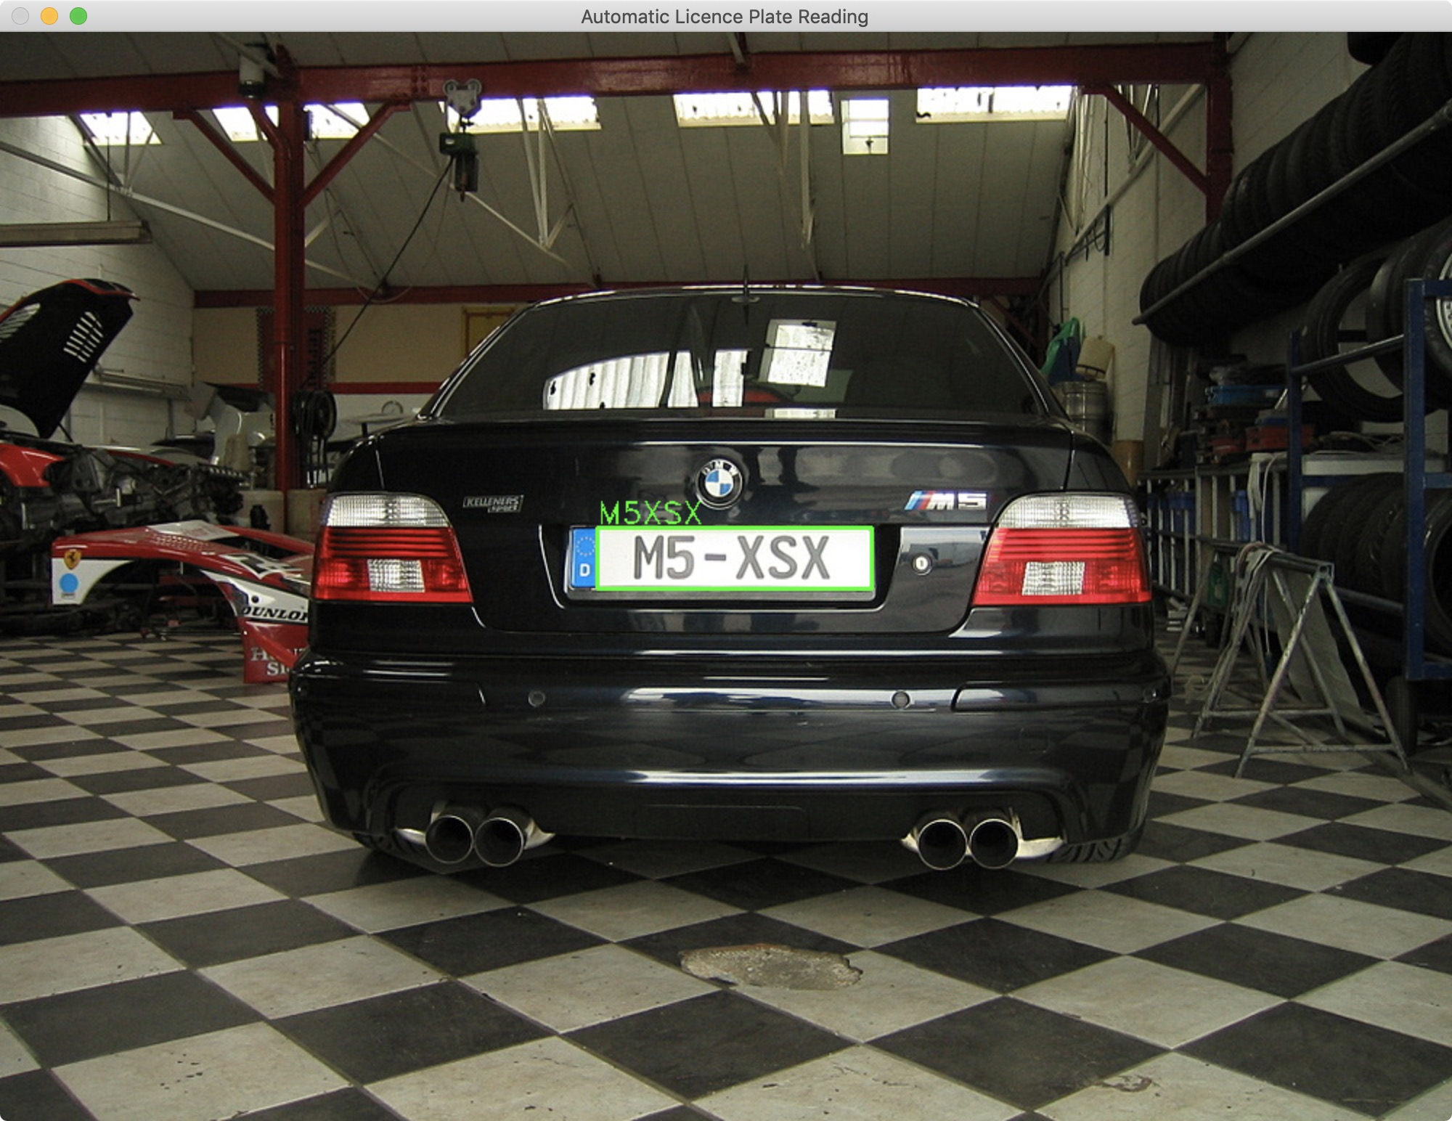
Results
AUTOMATIC LICENCE PLATE READING

Slide 10
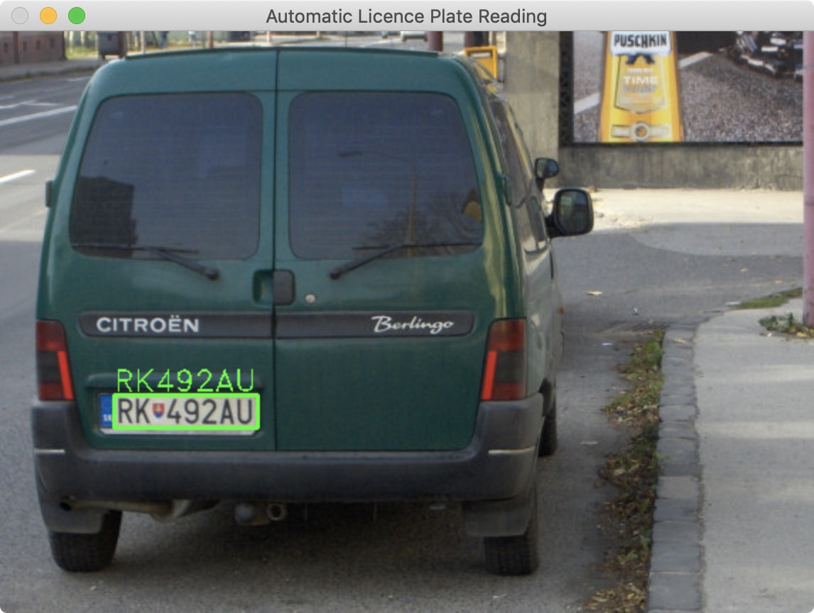
Results
AUTOMATIC LICENCE PLATE READING

